Slide 1
Meeting title here…

Slide 2
What is this all about?
This Summer, our whole organisation is focussed on ensuring The Leeds Way – the shared vision and values that we developed together in 2014 – continues to be the foundation for all we do and how we work.
We’re facing challenging issues in our priority areas including elective recovery, finance and workforce.
We want to refresh what we stand for and what matters most for our patients, for each of us in our professional roles and as partners in a complex health and care system.
We will achieve this by bringing the collective wisdom of our people together to reflect on the things we know to be important to us all, with a refreshed sense of shared purpose and direction.
There will be opportunities for everyone, at every level, to connect with their colleagues and share ideas and discuss their views.

Slide 3
What is happening during this Summer of Connecting?
There are a host of opportunities for people to come together – in person and online – with colleagues to share ideas and discuss views this Summer:
Via the Big Conversation – taking place online on Wayfinder
Reflect and Connect sessions – led by Value Makers
Team conversations – during existing meetings
Informal 1:1s – with just one colleague or in small groups
‘Ask the experts’ sessions – panel discussions and Q&A
Big Conversation event – where everyone is welcome to attend (run by Execs/NEDs/Value Makers)
‘Connect with Execs’ drop-in sessions
Tailor-made sessions set up for people without regular online access

Slide 4
About the Big Conversation
It’s a Trust-wide online conversation for everyone working at LTHT – so everyone can make their voice heard.
We’re asking everyone to spend some time this Summer thinking about at the vision, values and behaviours that make up The Leeds Way and challenge how we can improve or adapt what it is we do to make our Trust a better place to work to enhance our working lives and the experiences of our patients.
The Big Conversation is:
A safe place where you can share your experiences, views and ideas as well as read, comment and vote on the ideas of others.
Anonymous – your name will not be attached to anything you share
Independently analysed by our partners Clever Together
Open 24/7 for 6 weeks until 19 August so you can join at a time that suits you, from wherever you are
Accessible from any smart device – a PC, tablet or smartphone

Slide 5
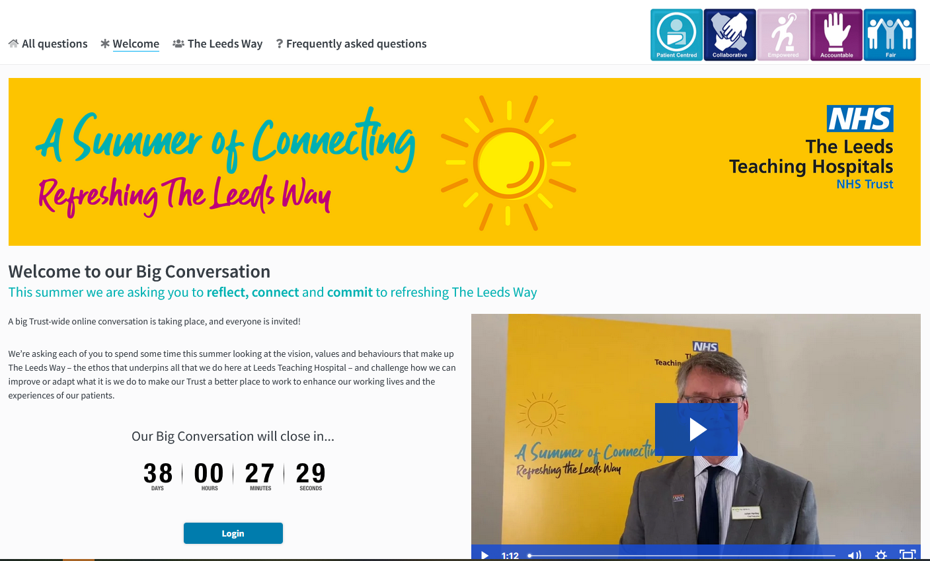
The Big Conversation on Wayfinder - https://leedsth.clevertogether.com

Slide 6
The three big questions everyone is discussing…
Reflect on The Leeds Way What does The Leeds Way mean to you and why is it important?
Connect to The Leeds Way What behaviours should we expect from everyone when we live and work in The Leeds Way? What behaviours would you like to see more of from yourself and others?
Commit to The Leeds Way How can we better live and work in The Leeds Way? What do we need to do to ensure our values are meaningful and practical?
Notes:
Talk about the format of the Reflect and Connect sessions here – with approximate timings

Slide 7
What people are telling us so far
The Leeds Way is…
“Our flag for others to join”
“An admirable concept but are we living by them”
“A collective identity”
“The right thing to do morally and ethically”
“Not a reflection of reality”

